Slide 1

TEAM Rose&Jack
Isabelle Kluser
Andreas Palm
Reto Stucki
05.11.2018

Slide 2
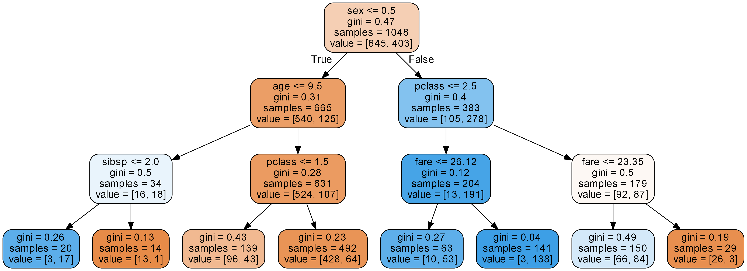
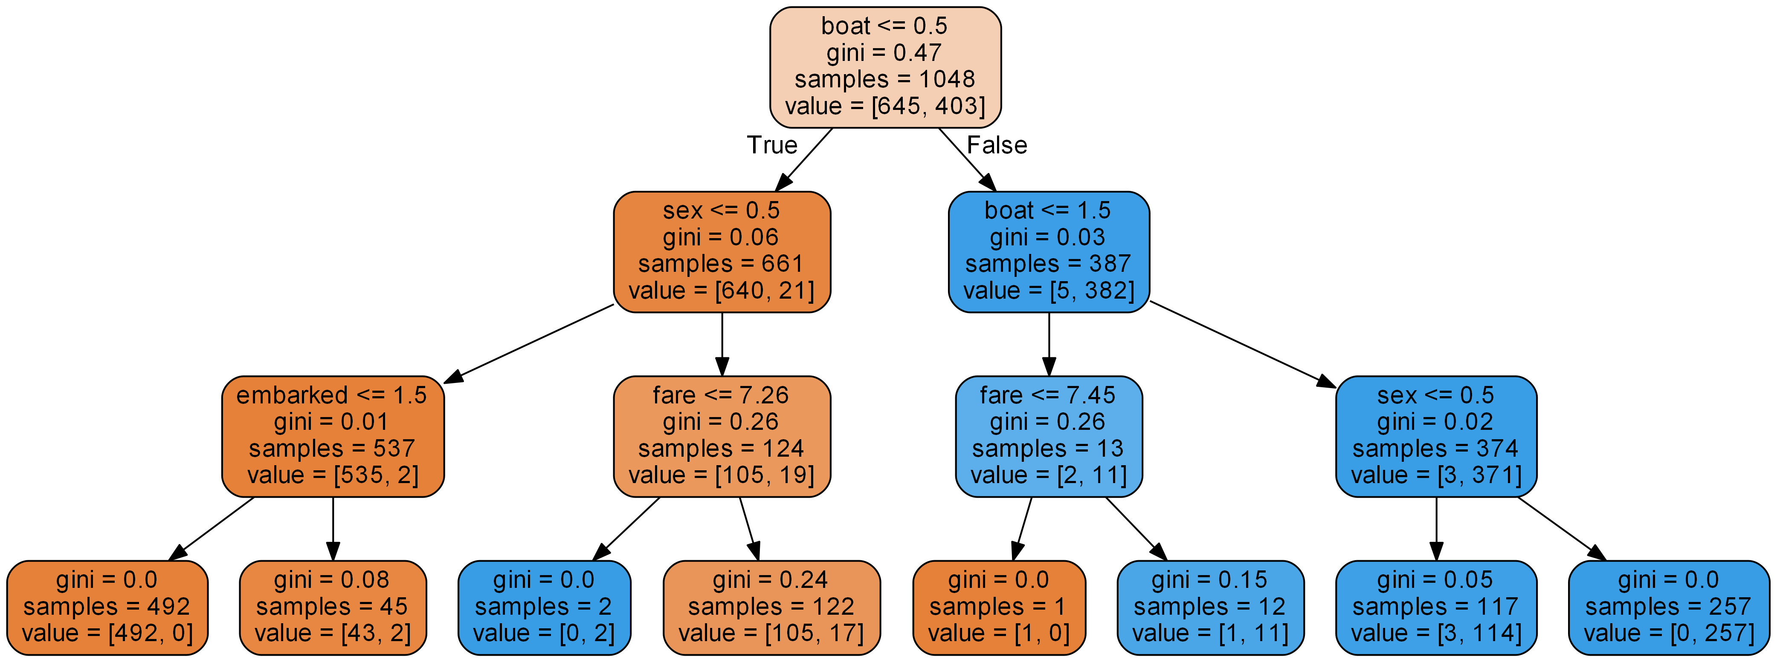
Pre vs. Post
Pre 0.82
Post 0.97 (with boat)
Pre suggests that gender might be the key to survive (Men 18.7% vs Women 72.5%)
However Post shows survival rate if not in a boat 1.29%

Slide 3
Technology
Moduls used:
Pandas
Sklearn (decision tree)
l_util (self-written for all data cleansing tasks)
Algo selected: decision tree
Reason: Visualisation of decision tree makes things transparent
Source Code sunken at: https://github.com/nojetlag/CASINFE2018/tree/master/Titanic
Notes:
- We found algo’s that

Slide 4
Learnings
Decision tree depth is very important (best results @3 for this case)
Team collaboration is much easier when using a common repository
Taking time to understand results

